Slide 1
Reducing poverty in Asia
Kathryn Gadberry

Slide 2
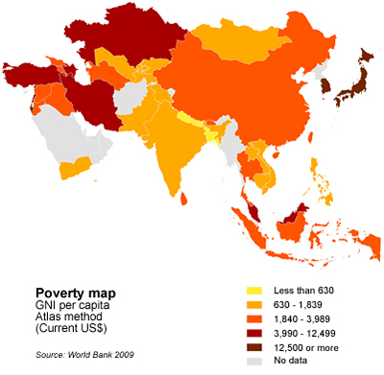
Analysis
Which World Bank Indicators are the most significant in predicting how effectively developing countries in the Asia Pacific are able to lift people out of poverty?

Slide 3
Background
10 Most Populous Developing Nations (Asia)
Developing Country: a poor agricultural country that is seeking to become more advanced economically and socially
Almost 2/3 of the world's population lives in Asia
4 billion people are scattered throughout rural areas on roughly 17 per cent of the world’s surface.
Poverty = a rural problem: 80 to 90 per cent of poor people live in rural areas in most major developing countries
Significantly reducing poverty in a large population is crucial to achieving the primary Millennium Development Goal of halving poverty by 2015
Bangladesh
Cambodia
China
India
Indonesia
Myanmar
Nepal
Philippines
Thailand
Vietnam
Notes:
http://www.ruralpovertyportal.org/region/home/tags/asia
10 of the most populous and significant countries in the developing world

Slide 4
Indicators
Rural farmer’s basic amenities are limited – access to safe water supply, sanitation and electricity
Women are the backbone of many smallholder farms, but are limited by ownership inequality and decision making power
43% of the world’s agricultural labor force (70% in some countries)
Variables (Community Development Measures)
Indicator IDs
Access to electricity, rural (% of rural population) | EG.ELC.ACCS.RU.ZS
Improved water source, rural (% of rural population with access) | SH.H2O.SAFE.RU.ZS
Improved sanitation facilities, rural (% of rural population with access) | SH.STA.ACSN.RU
Employment in agriculture, female (% of female employment) | SL.AGR.EMPL.FE.ZS
Rural poverty gap at national poverty lines (%) | SI.POV.RUGP
Notes:
Rural poverty gap at national poverty lines (%)
Rural population (% of total population)
Poverty gap at $1.90 a day (2011 PPP) (%)

Slide 5
Data Sources
World Bank Data: http://data.worldbank.org/country
Package 'WDI' - R – CRAN: https://cran.r-project.org/web/packages/WDI/WDI.pdf
Rural Poverty Portal: http://www.ruralpovertyportal.org/region/home/tags/asia

Slide 6
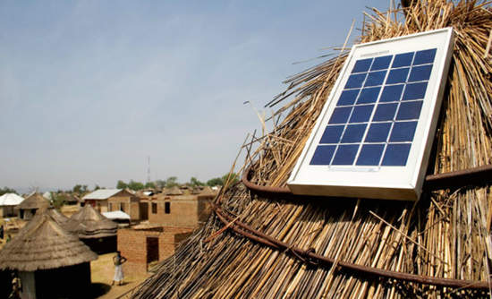
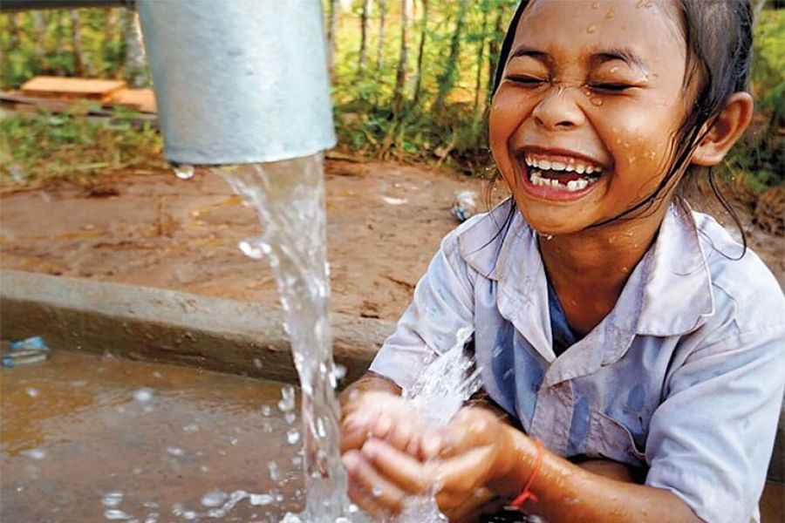
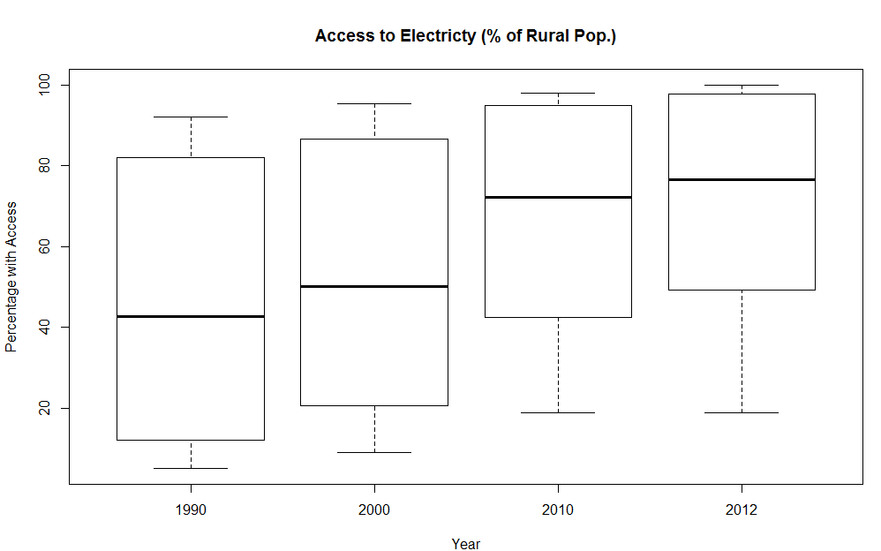
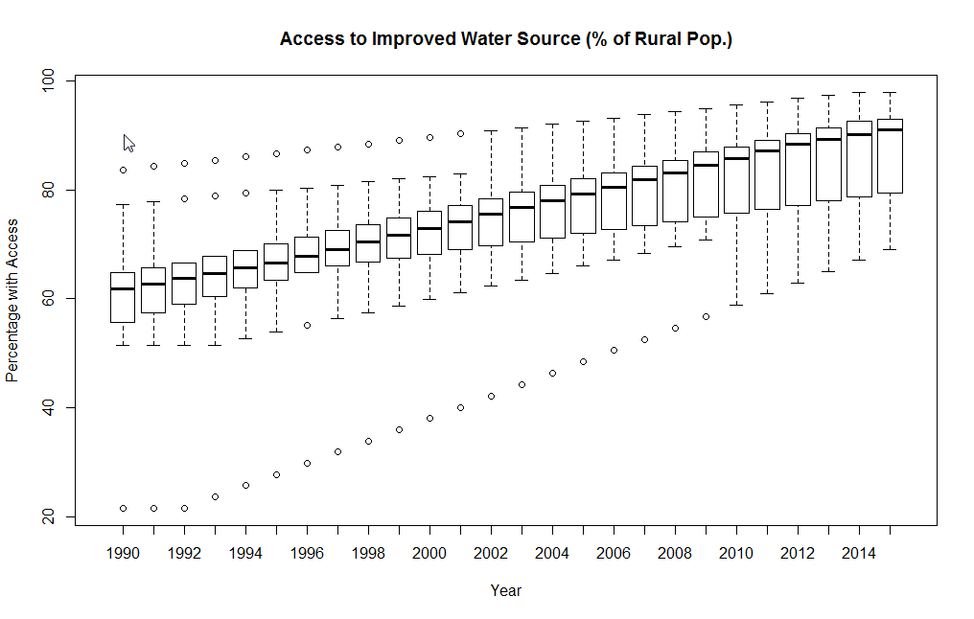
Data exploration
Notes:
Stacked bar chart of population and rural population as a % of total

Slide 7
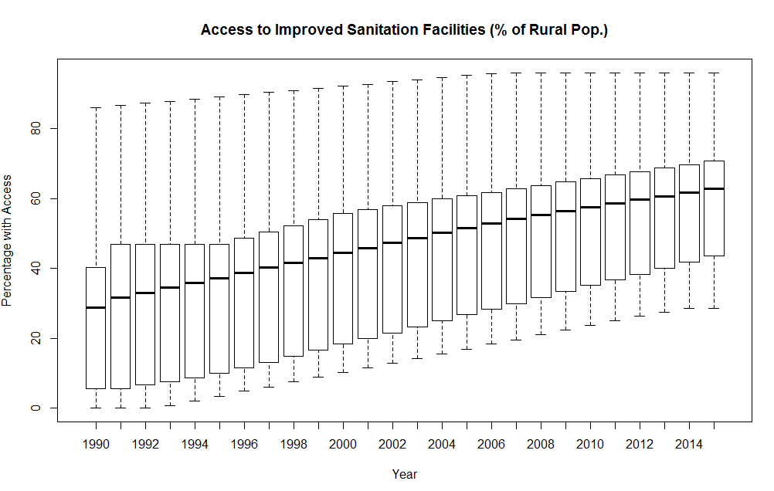

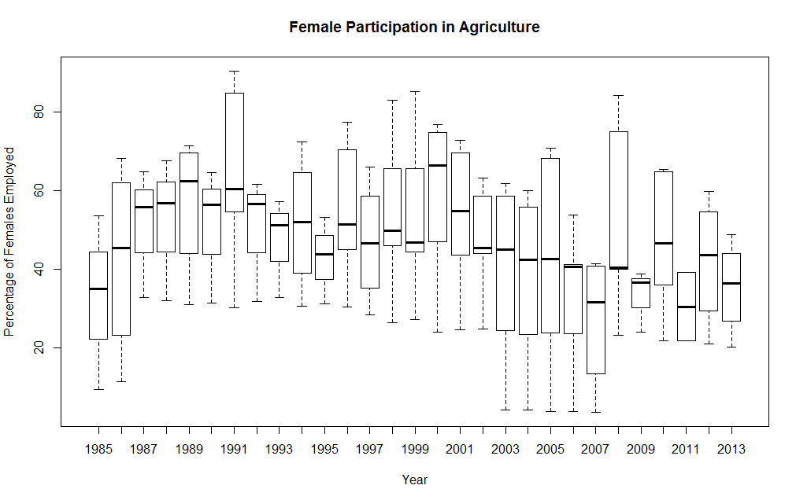
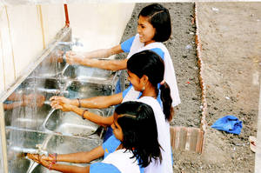

Slide 8
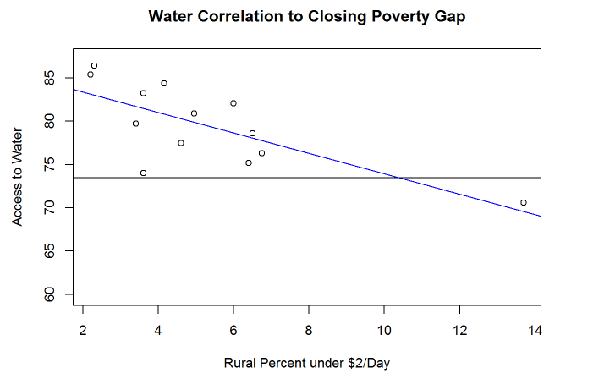
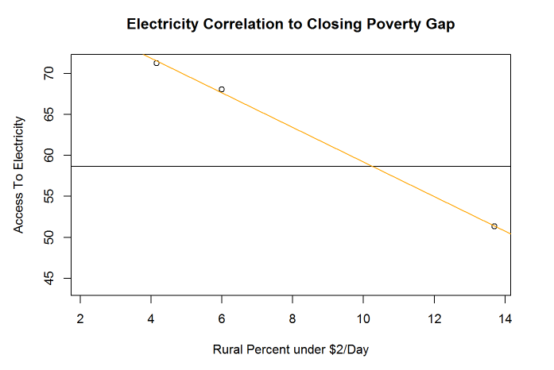
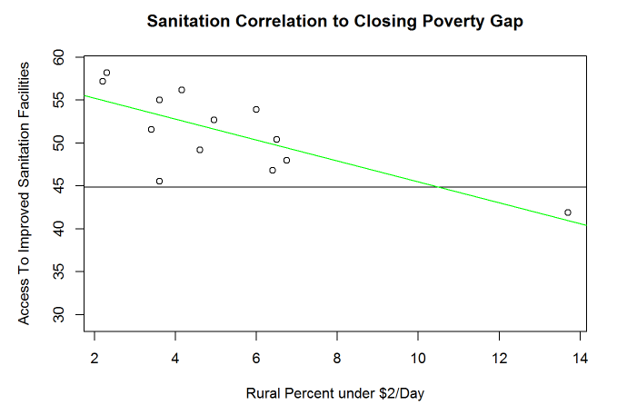
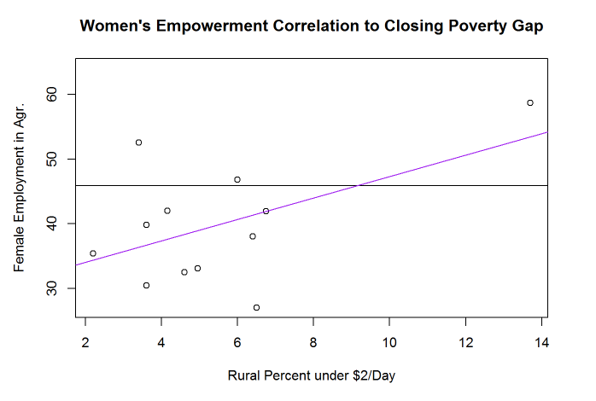
Linear Relationships: Development Measures & the Poverty Gap
Notes:
Add lines and better fit to graphs
What is the hypothesis here?????

Slide 9
Setting up for analysis
Filter and subset World Bank data by country, indicator and timeframe
Set date data to as.numeric()
Restructure and arrange data; factors to variables using tapply function
Rename variable columns
Reformat the observations and variables into a data frame
Remove NA values
Notes:
Explain more about code and wrangling process in bullet points

Slide 10
Methodology: Linear regression

Slide 11
Linear Relationships
Strongest linear relationships in order from greatest (closer to -1) to least (closer to 0)
[1] -0.999437
[1] -0.7393785
[1] -0.735621
[1] 0.5275307
Electricity
Sanitation
Water
Women’s Empowerment

Slide 12
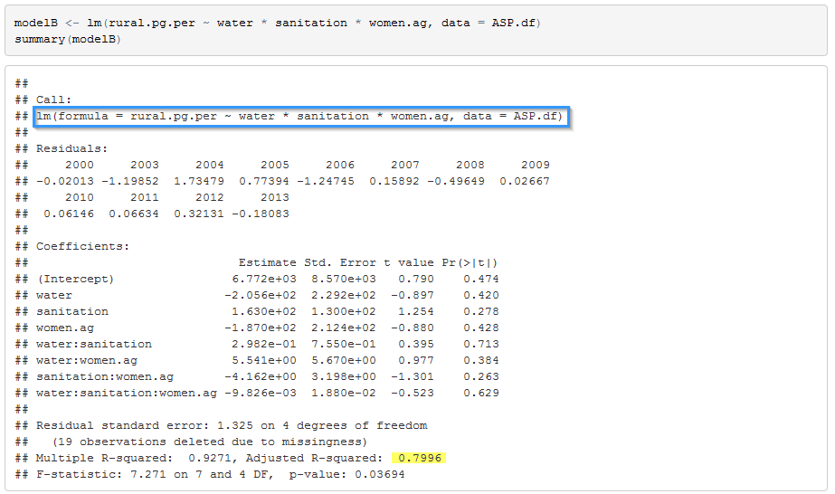
Multiple Linear regression

Slide 13
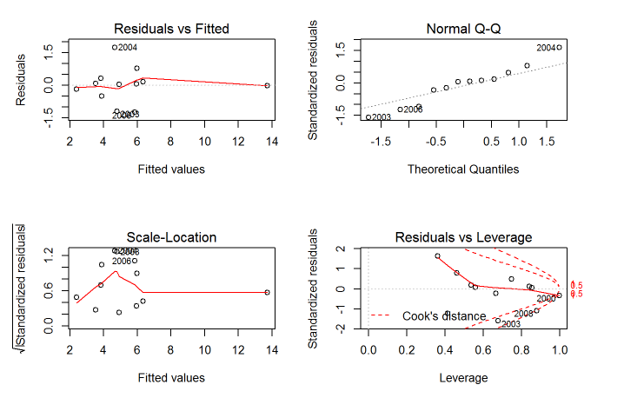
Multiple Linear Regression

Slide 14
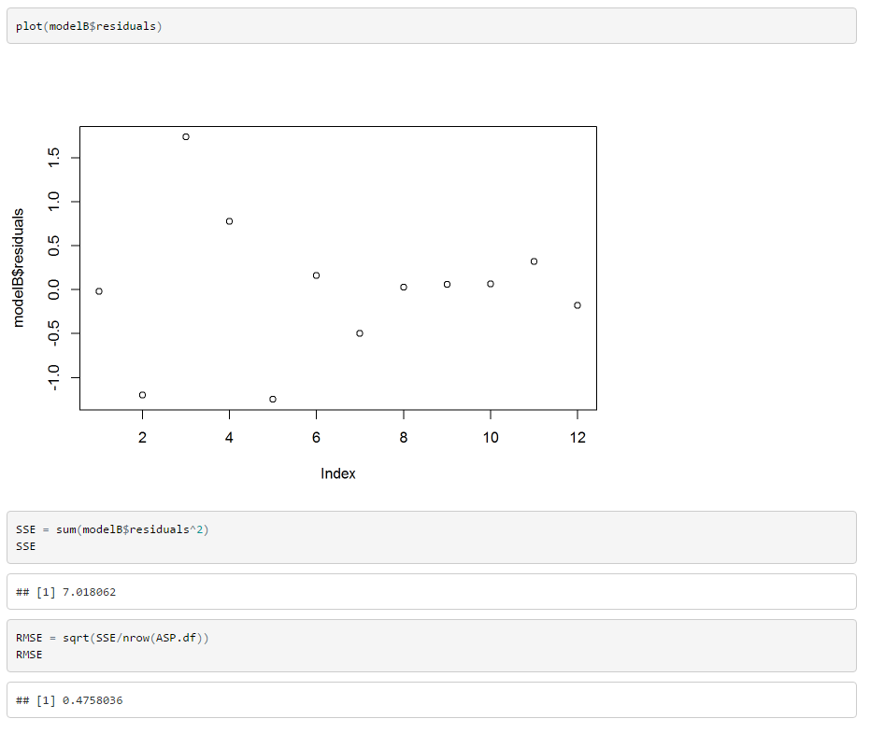
Residuals
The residual plot shows us a pattern indicating that the model may not be perfectly fitted to the true relationships between the World Bank Indicators and the Rural Poverty Gap.

Slide 15
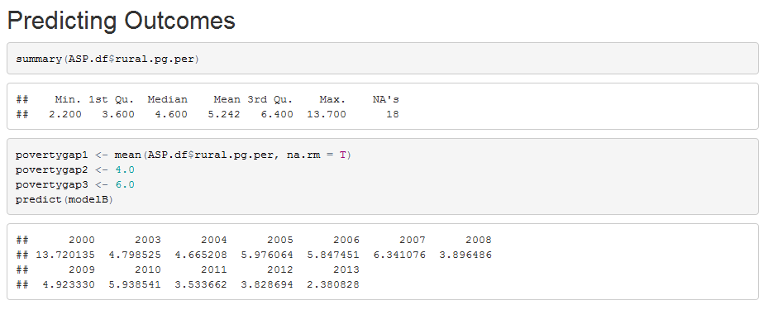
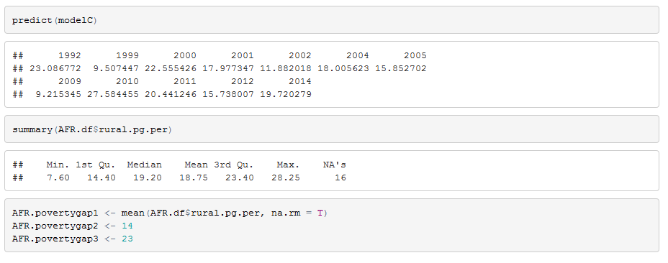
Making predictions—Testing data

Slide 16
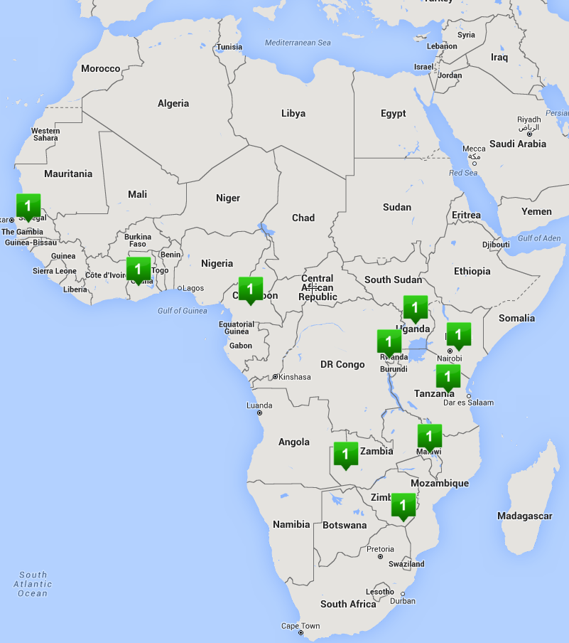
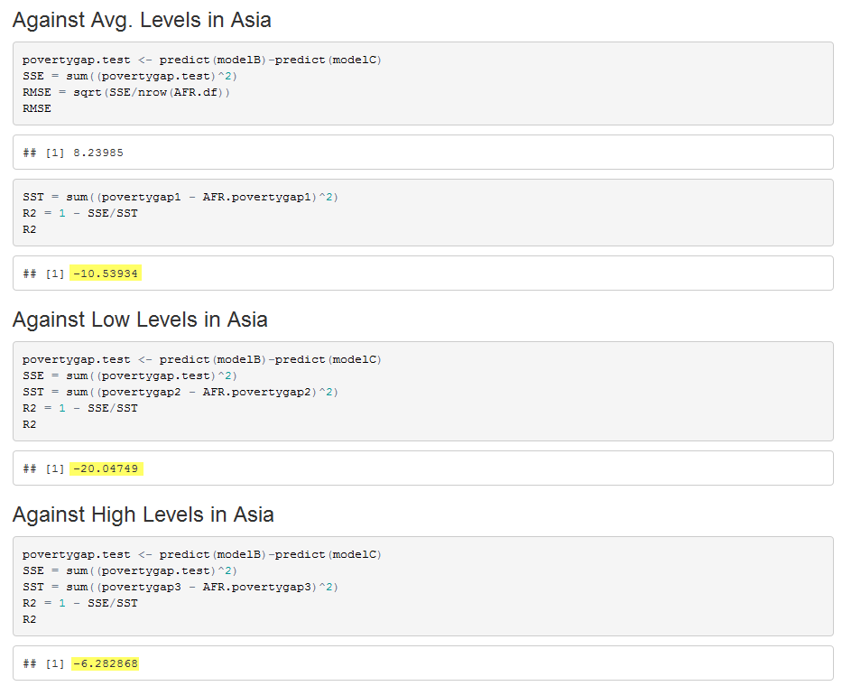
Testing Data
The indicators performed best against other populations with higher levels of the rural population living under $2/day, but Model B would not be predictive to any of the World Bank Indicators when applied to data from Africa.

Slide 17
Conclusions & RECOMMENDATIONS

Slide 18
1. Poverty Line (<$2/day) = βo + β1WATER1 + β1 SANITATION1 + β1WOMEN1 + u
Invest more in more programs that support indicators with the highest correlation to lowering population living below the poverty line: water, sanitation and then women’s agricultural practice
Get more research and data on electricity and re-run analysis; potentially highly predictive
2. NGO’s and Governments need to collect A LOT more data
Ensure standardization of data collected
Test other vastly developing regions in the world (Africa)
3. Explore and analyze other sustainable techniques:
Agricultural training
Access to internet/technology
Risk management planning
4. Take other economic and sustainability metrics into account for analysis
Education/Literacy
Prominent Industries/local resources
Exchange/Inflation Rates
Openness of Government

